Slide 1
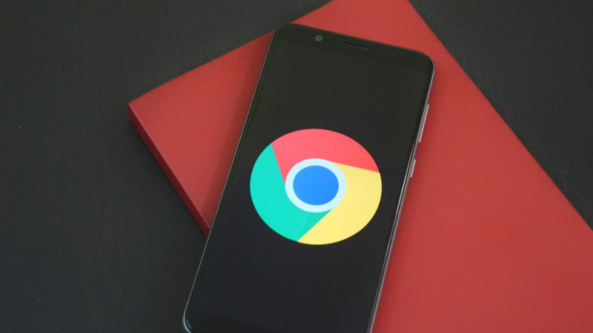
Google Play Store App Dataset
Jingying Yin & Yining Zhang

Slide 2
Project idea
Overview of all apps in google play store
The apps be sort or filtered by different attributes
Charts for the app’s category, rating and reviews

Slide 3
Programing language
HTML – web design
BootStrap – visualization
PHP & Java Script – web develop
MySQL – database

Slide 4
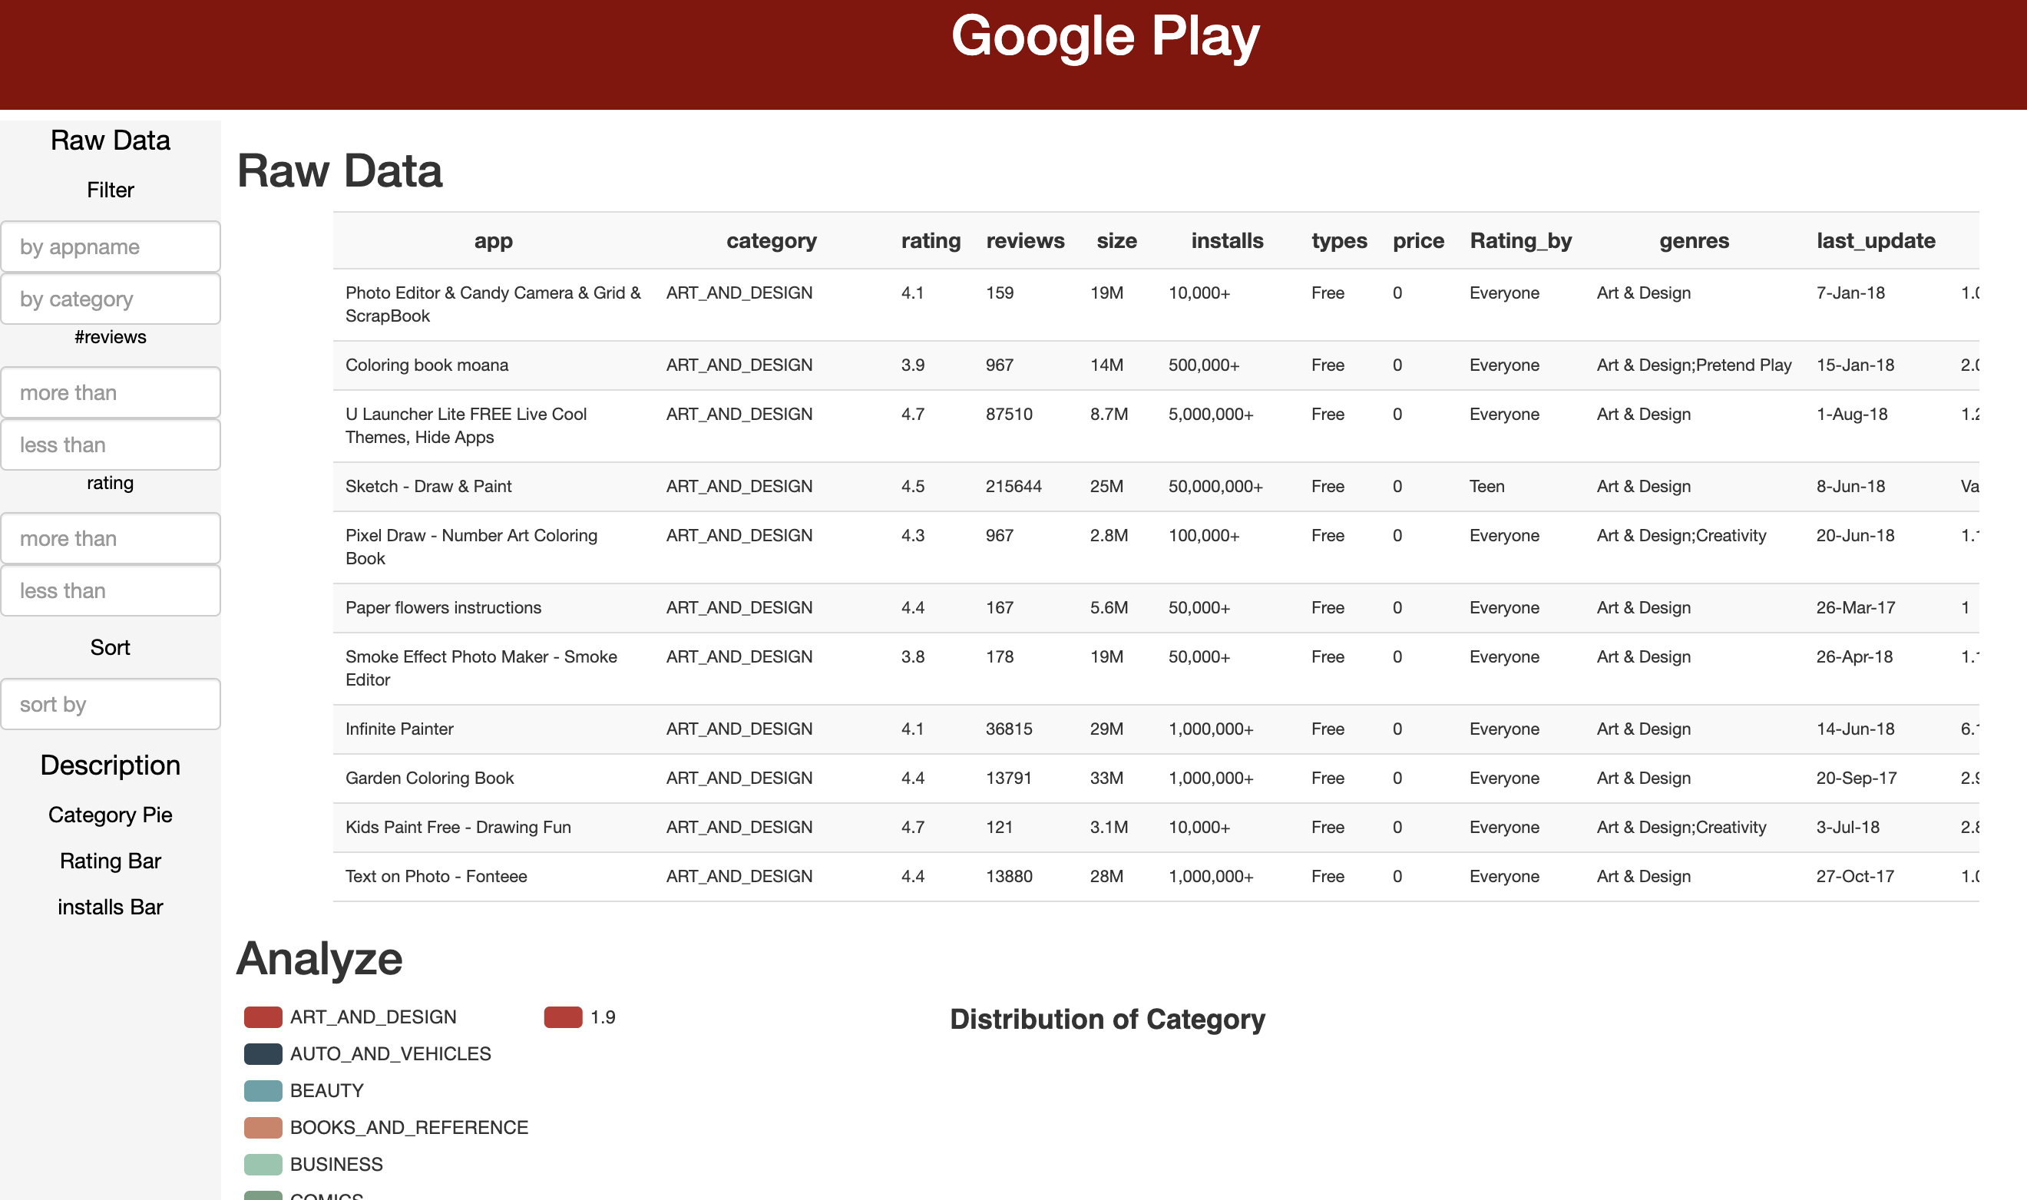
Overview of the webpage
Raw data
show the data sets
for the Filter & sort function
Description
show the pie chart of Category
show the bar chart of Rating
show the bar chart of Installs

Slide 5
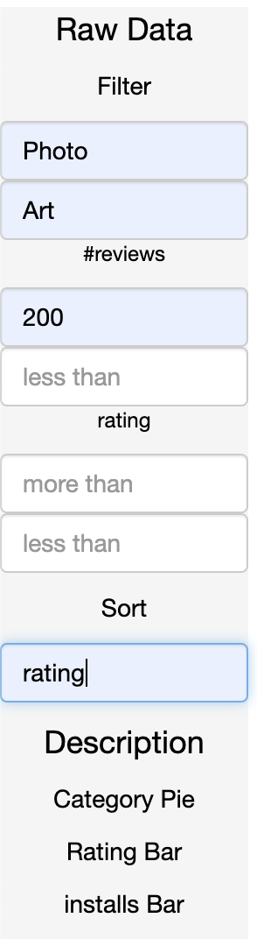
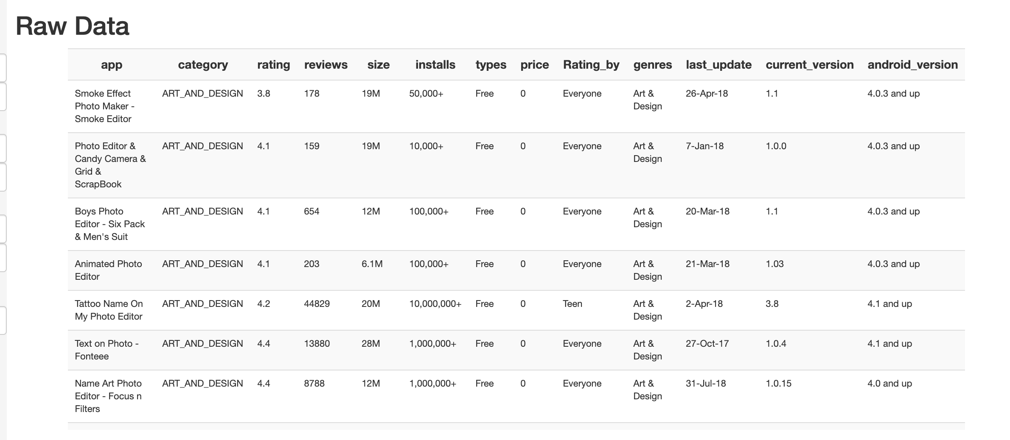
Tools of the webpage

Slide 6
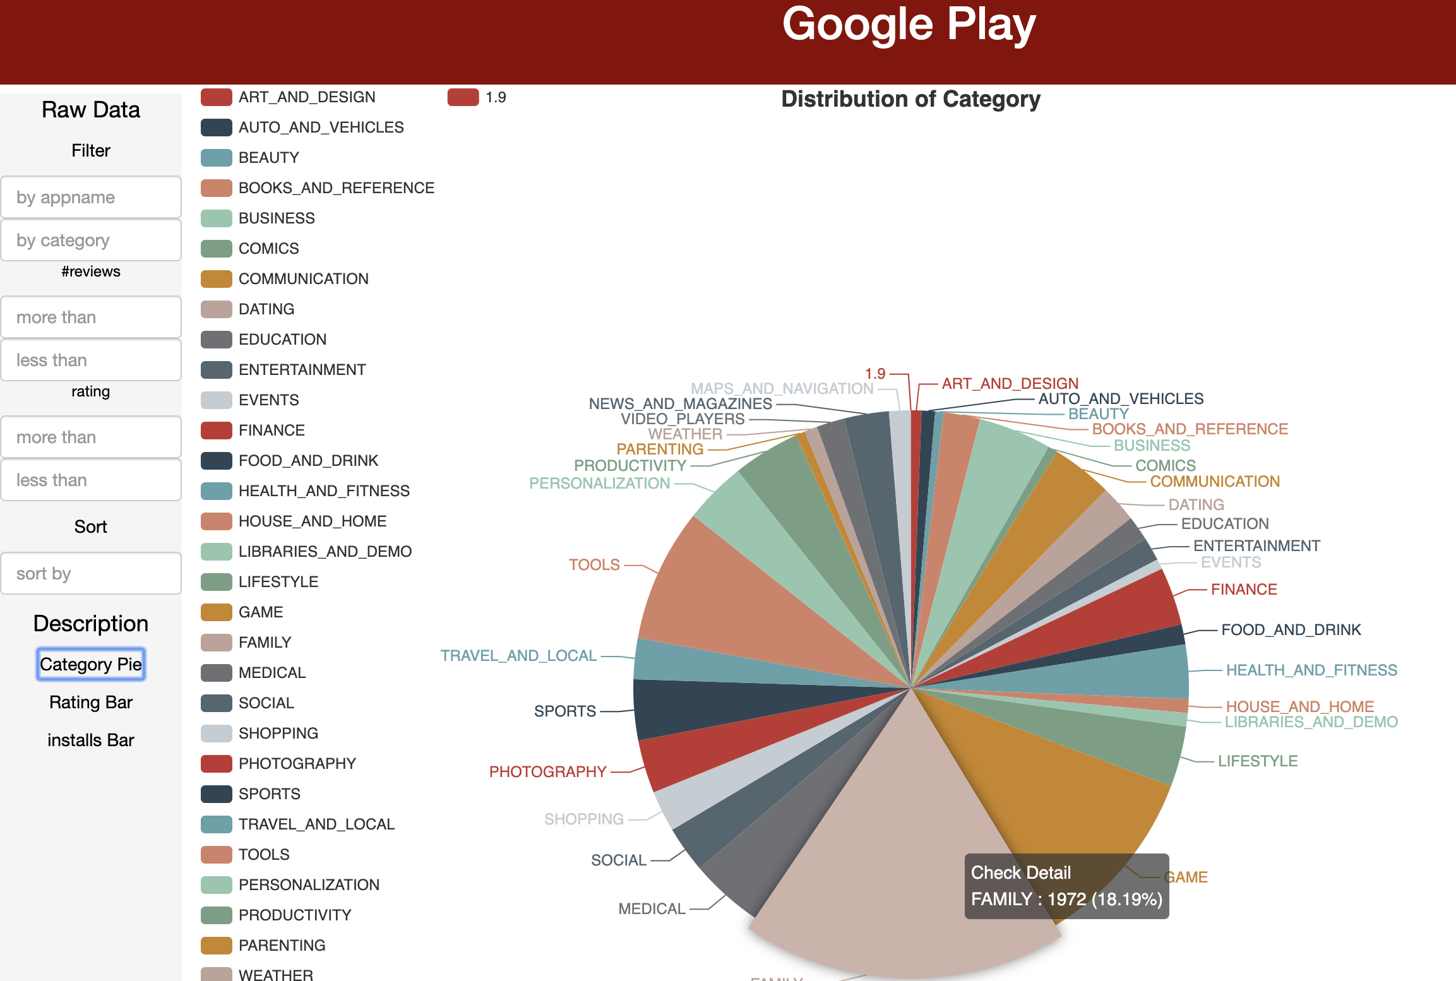
Description: pie charts
Category Pie
Percentage of each category for all the apps

Slide 7
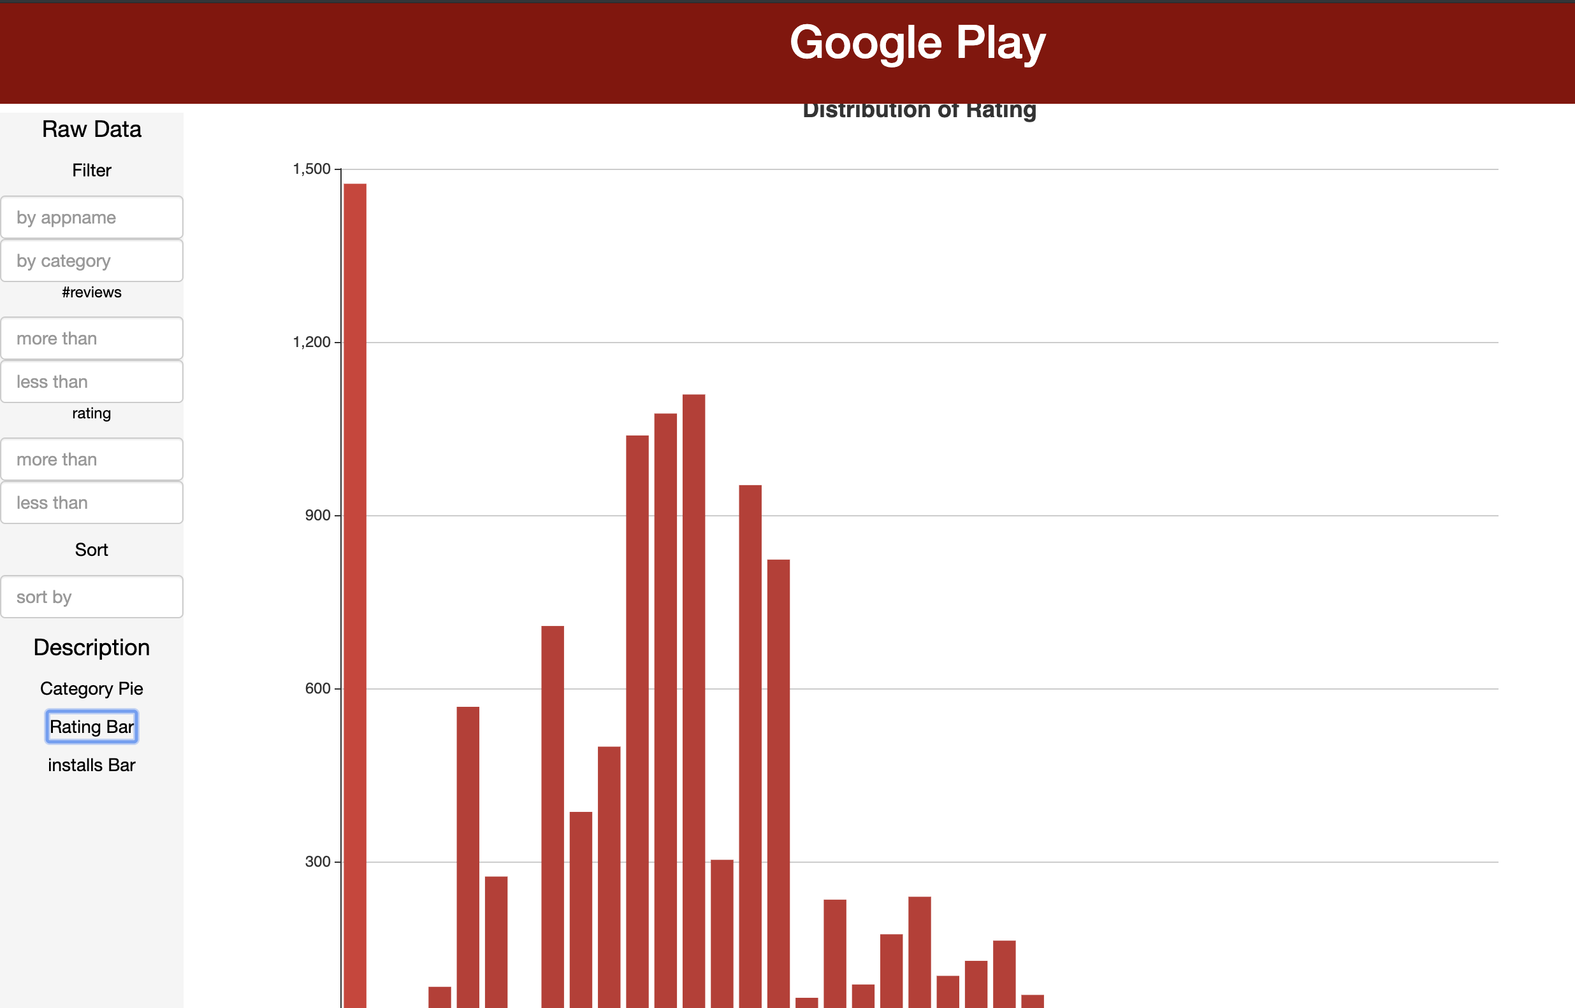
Description: bar charts
Rating bar :
The number of the app by different rates

Slide 8
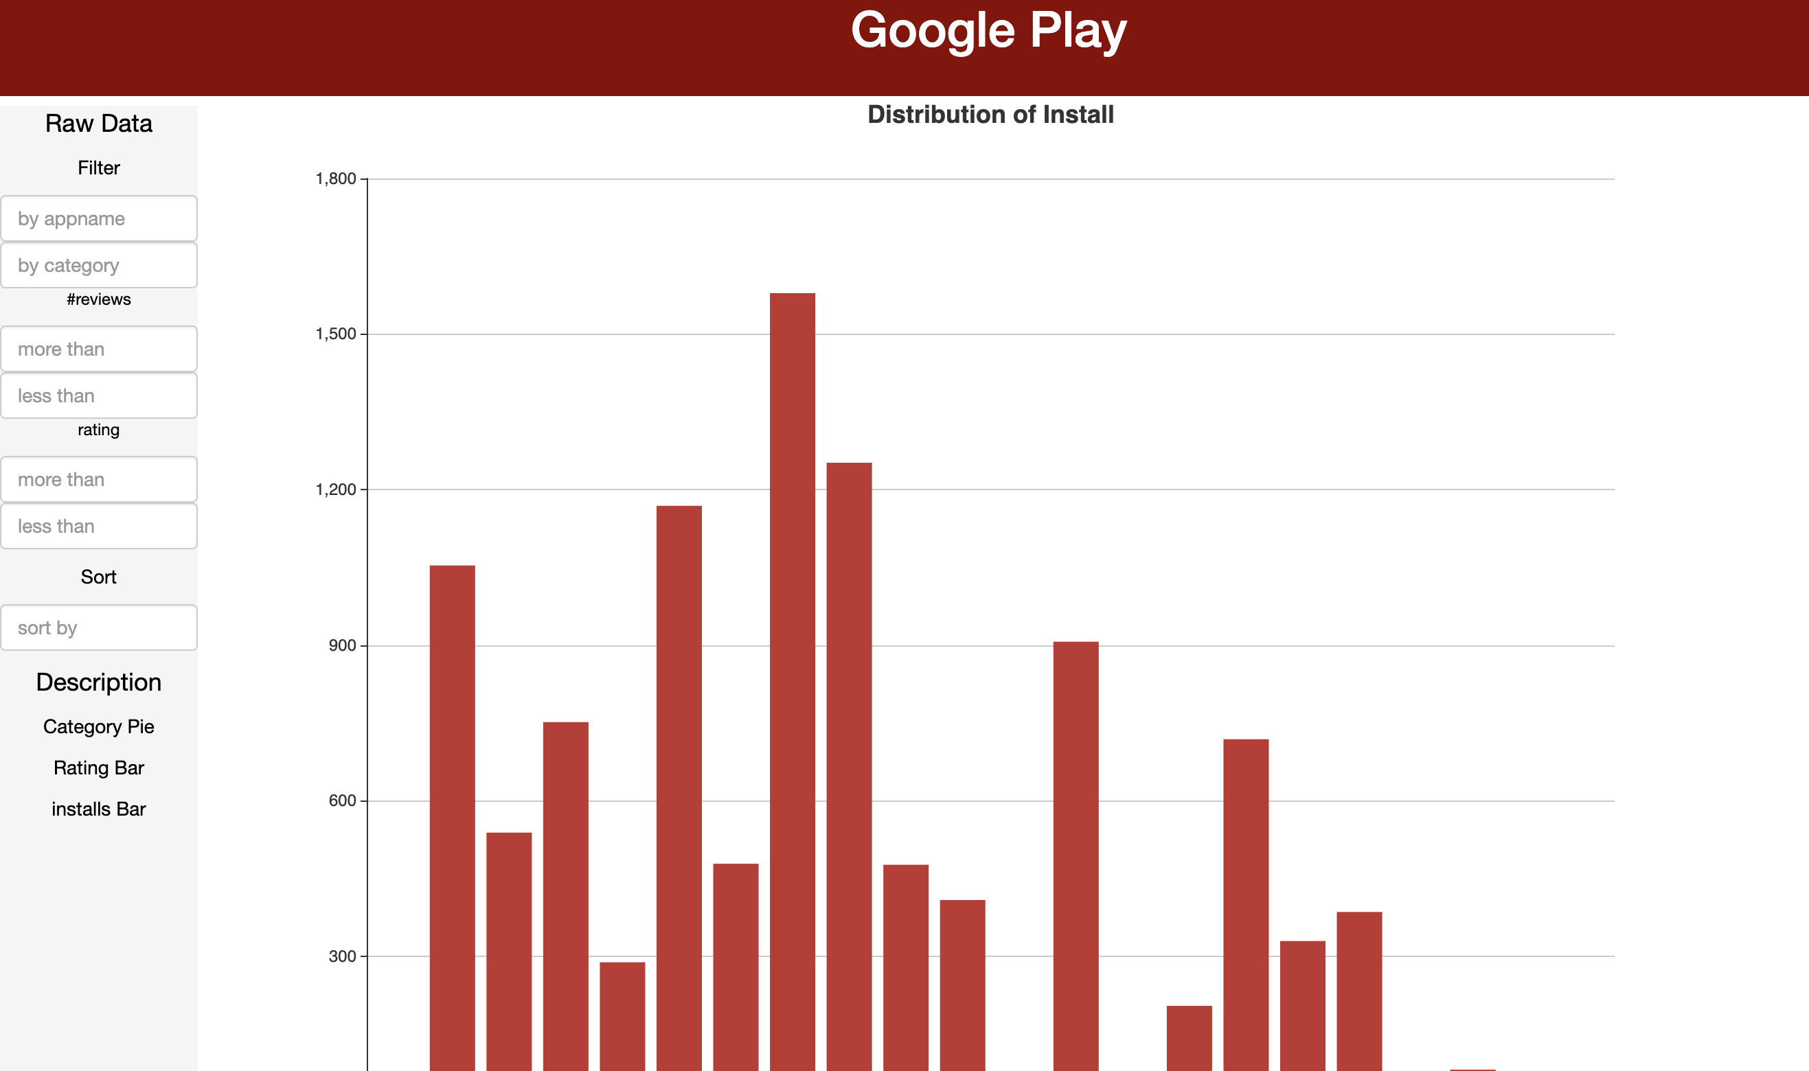
Description: bar charts
Install bar :
The number of apps by different download times

Slide 9
Thank You !
Jingying Yin & Yining Zhang

